Slide 1



Topix Core 30
Group members:
Frankie Li
Howard Lau
Anson Lee
Yolanda Cheng
Portfolio Optimization

Slide 2
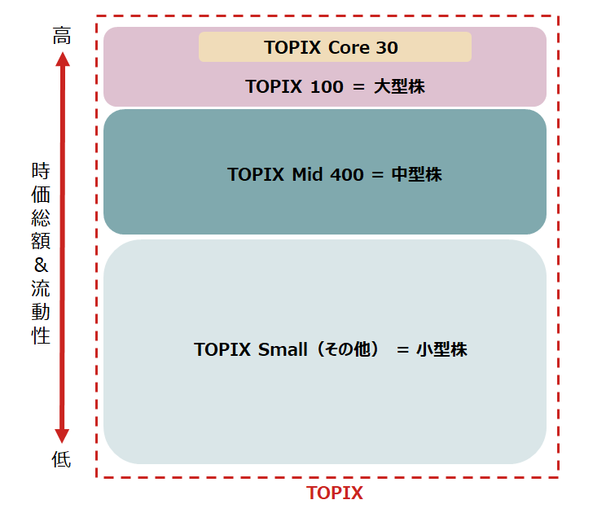
Introduction
What is TOPIX (Tokyo Stock Price Index)?
Key stock market index that tracks the performance of all the companies listed on the Tokyo Stock Exchange (TSE)
Comprises the largest and most liquid stock on TSE
Benchmark for top-tier companies
Reflecting the performance of major plays in Japanese economy
Examples: TOPIX Core30, TOPIX Large70, TOPIX Mid400, etc
Why TOPIX Core 30?
Japan stock market become a new famous market since the beginning of this year
After the sign reversal of japanese interest rate from negative to positive
TOPIX Core30 have limited components but large enough for analyzing

Slide 3
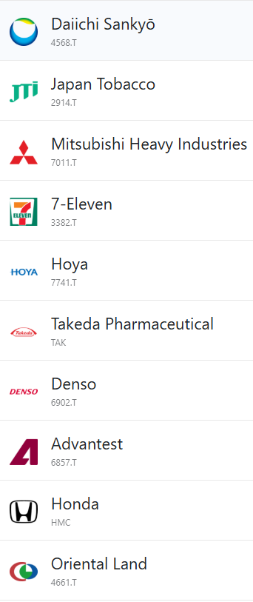
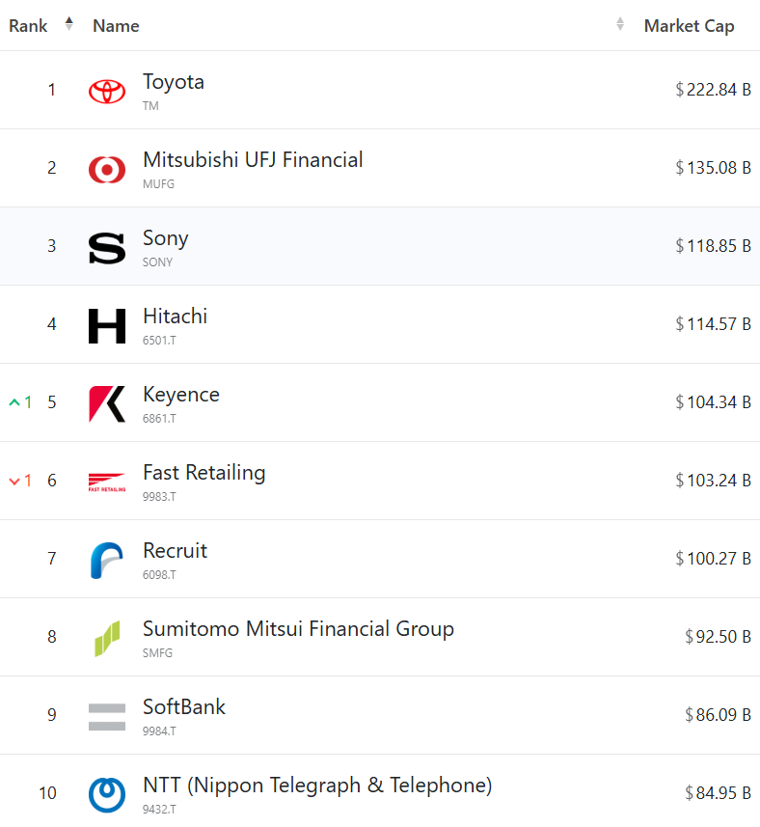
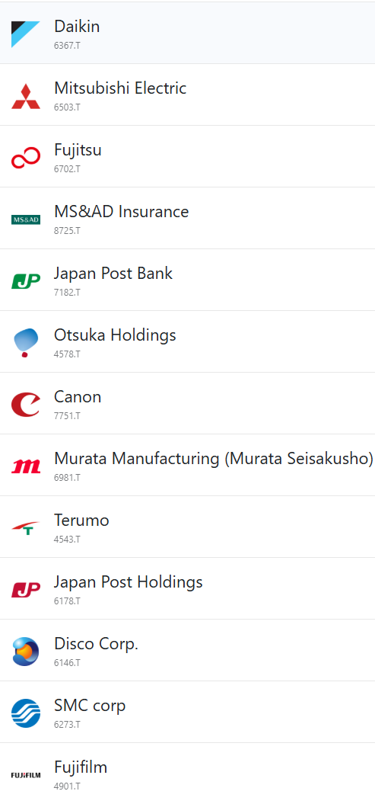
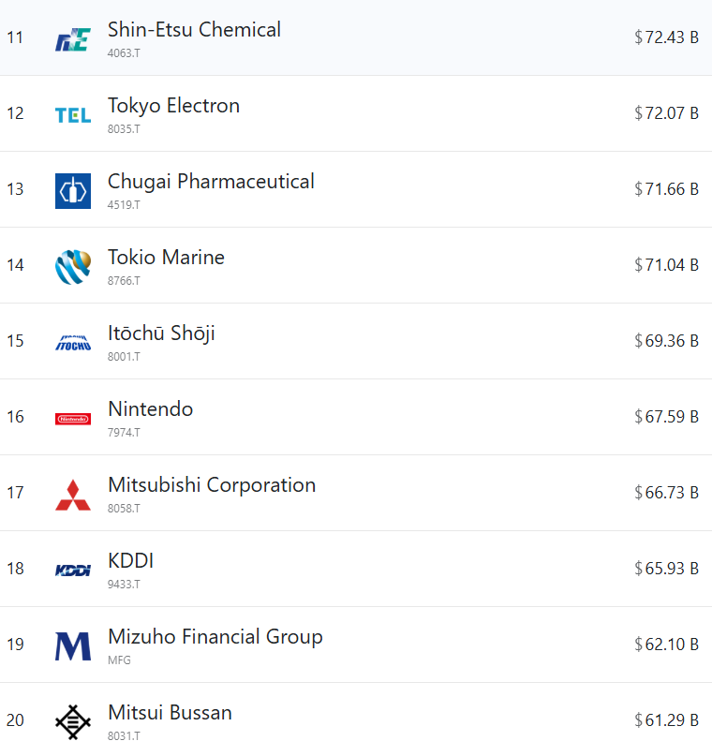
Components

Slide 4
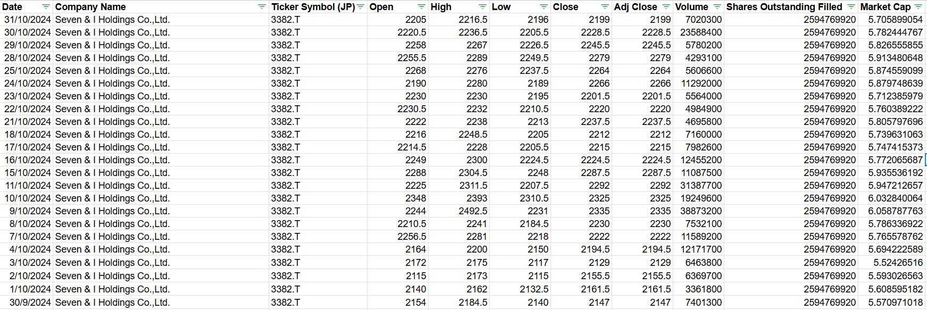
Data Preparing
Period of interest:
Oct 2022 to Oct 2024
Topix Core 30 fixed their component within this period
Data Collection:
from yahoo finance
Period of data collected: Jan 2020 to Oct 2024
More data for estimate the annualized volatility and return (reduce numerical error)

Slide 5
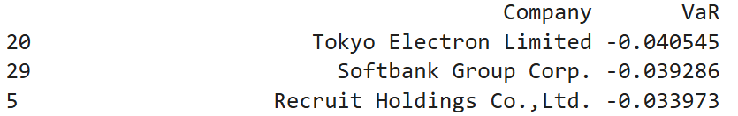
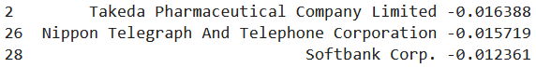
Risk analysis (VaR)
For all 30 components,
Calculate the VaR at 95% confidence interval (with daily data)
Top 3 VaR value (loss more money)
Last 3 VaR value (loss less money)

Slide 6
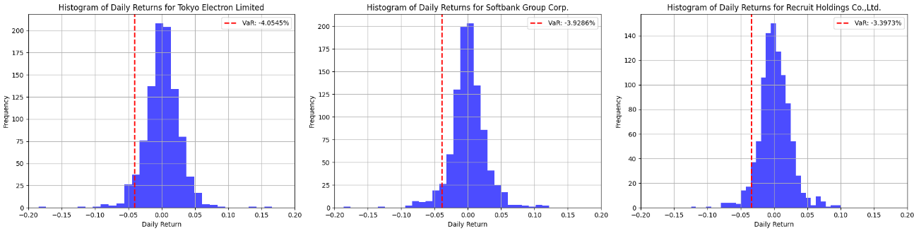
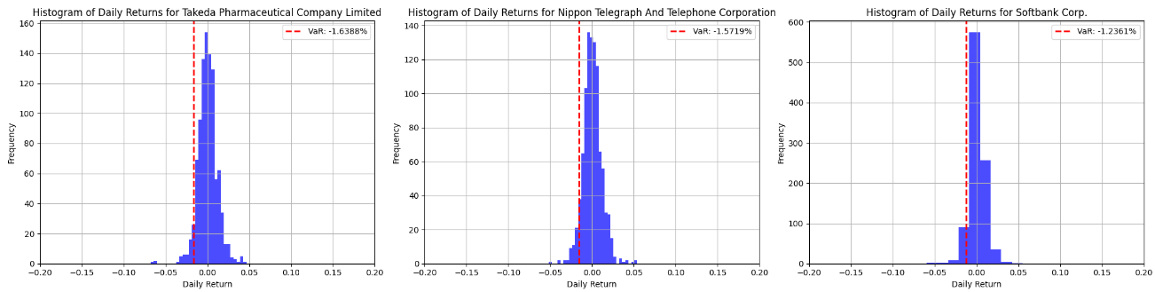
Risk analysis (VaR-Histogram)
Top 3 VaR value (loss more money)
Last 3 VaR value (loss less money)

Slide 7
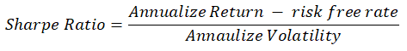
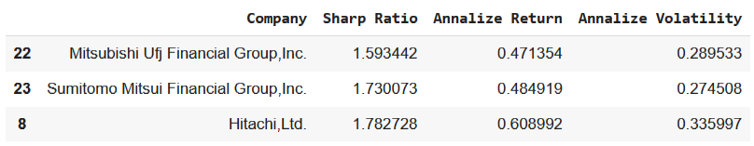
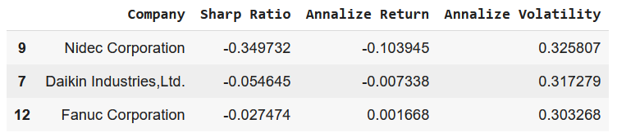
Risk analysis (Sharpe Ratio)
For all 30 components,
Calculate the Sharpe ratio
Top 3 Sharpe Ratio
Last 3 Sharpe Ratio
Risk free rate = 0.01

Slide 8
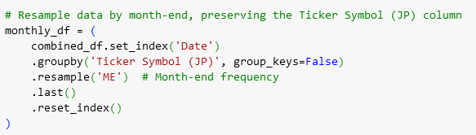
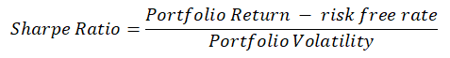
Portfolio Optimization
Portfolio optimization rebalance monthly
Less daily noise
Larger return value for comparison
Resample the price with month-end frequency
For 1-Nov 2022 to 31-Oct 2024
Find out the effective frontier for each month
Apply optimization by maximizing the sharpe ratio of portfolio
Each weight fixed in the range from 0.008 to 0.1 (same as TOPIX Core30)

Slide 9
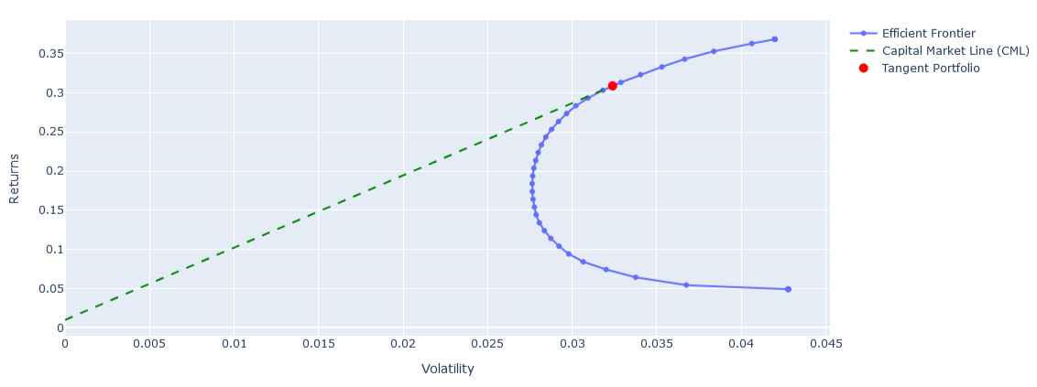
Efficient Frontier with CML (31-Oct 2024)
(0.03239, 0.3087)
0.01

Slide 10
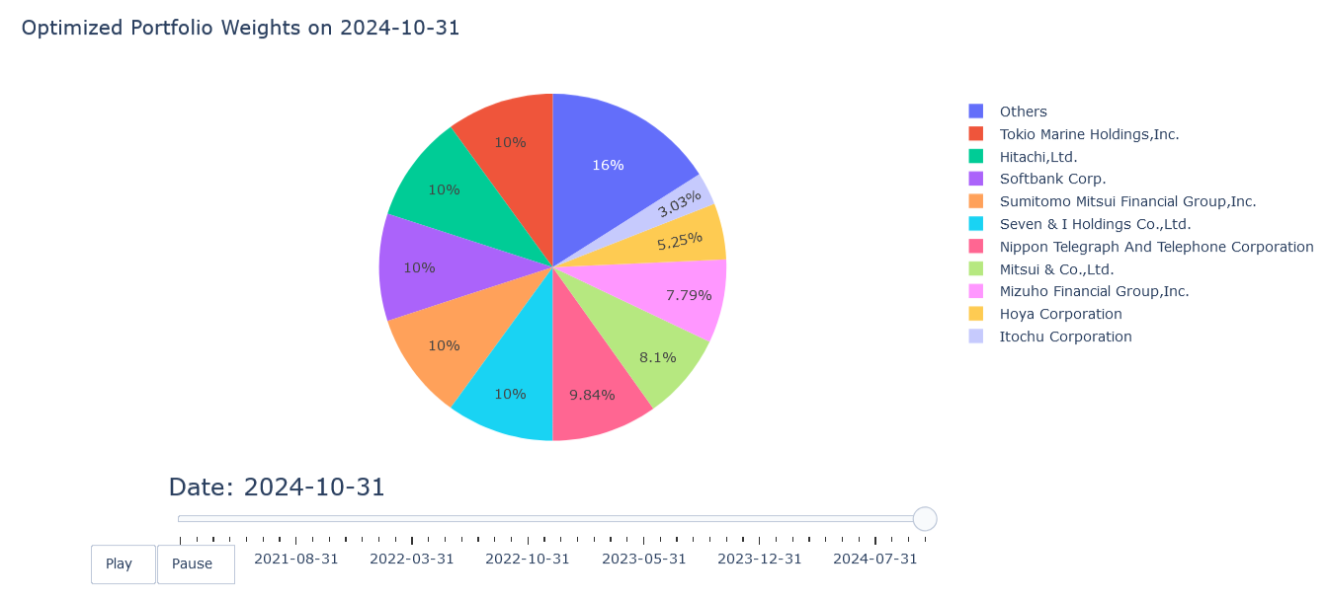
Target Portfolio Weight Distribution
Annualized volatility: 0.03239
Annualized portfolio return: 0.3087

Slide 11
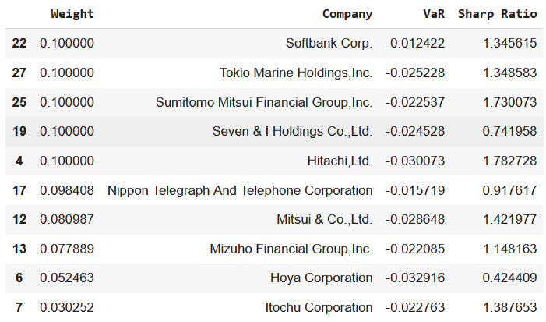
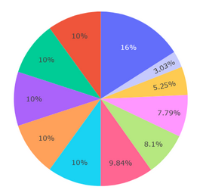
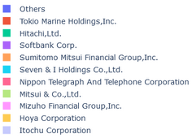
Target Portfolio Weight Distribution
Among all large weights,
The sharpe ratios are relatively high
VaR does not show large correlation (daily data)

Slide 12
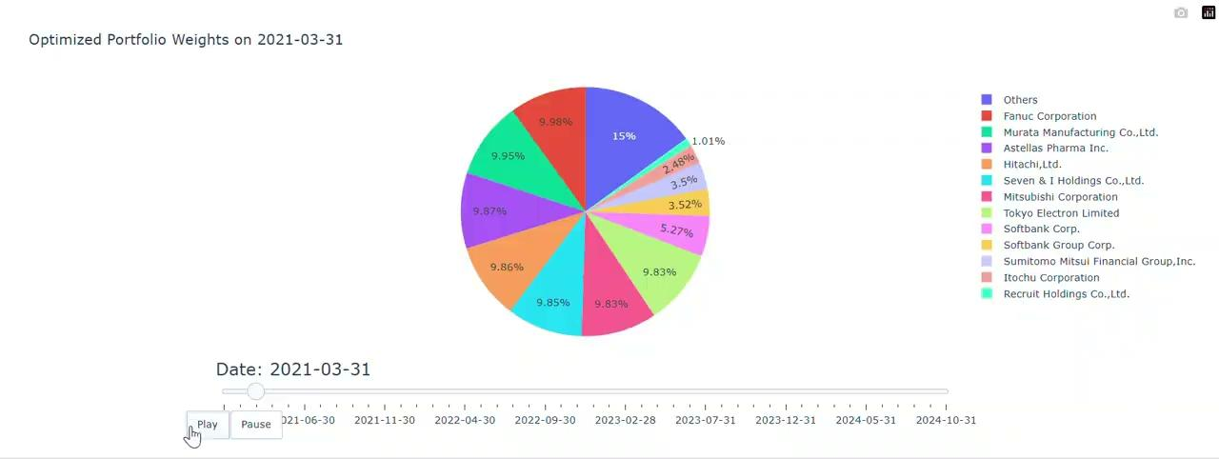
Optimized Portfolio Weight (timeline)

Slide 13
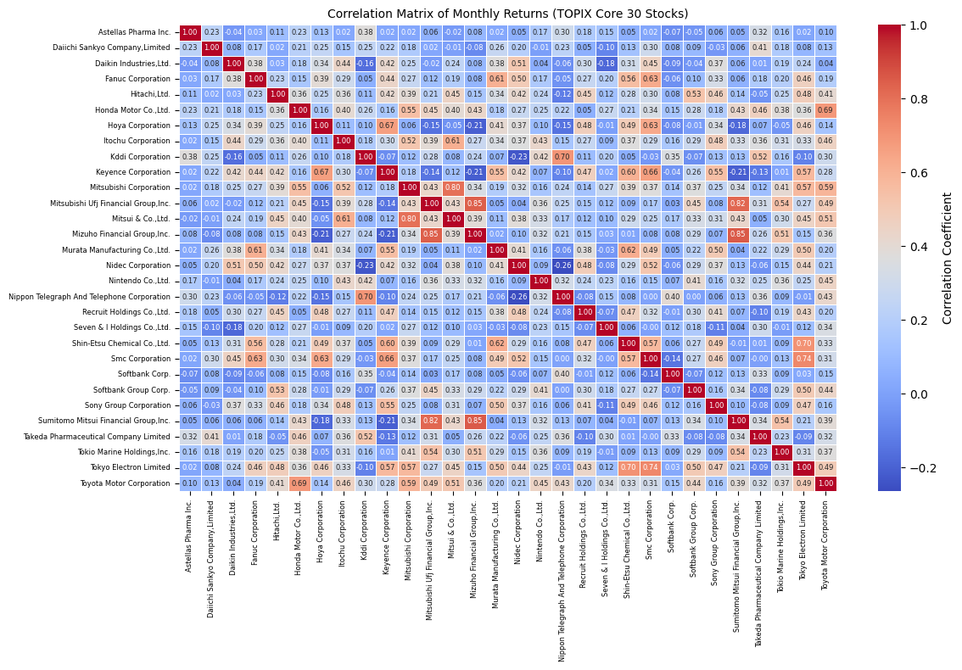
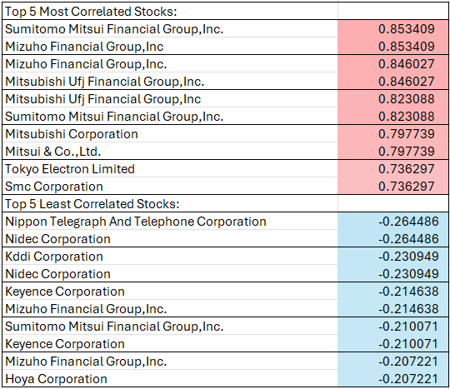
Correlation Matrix

Slide 14
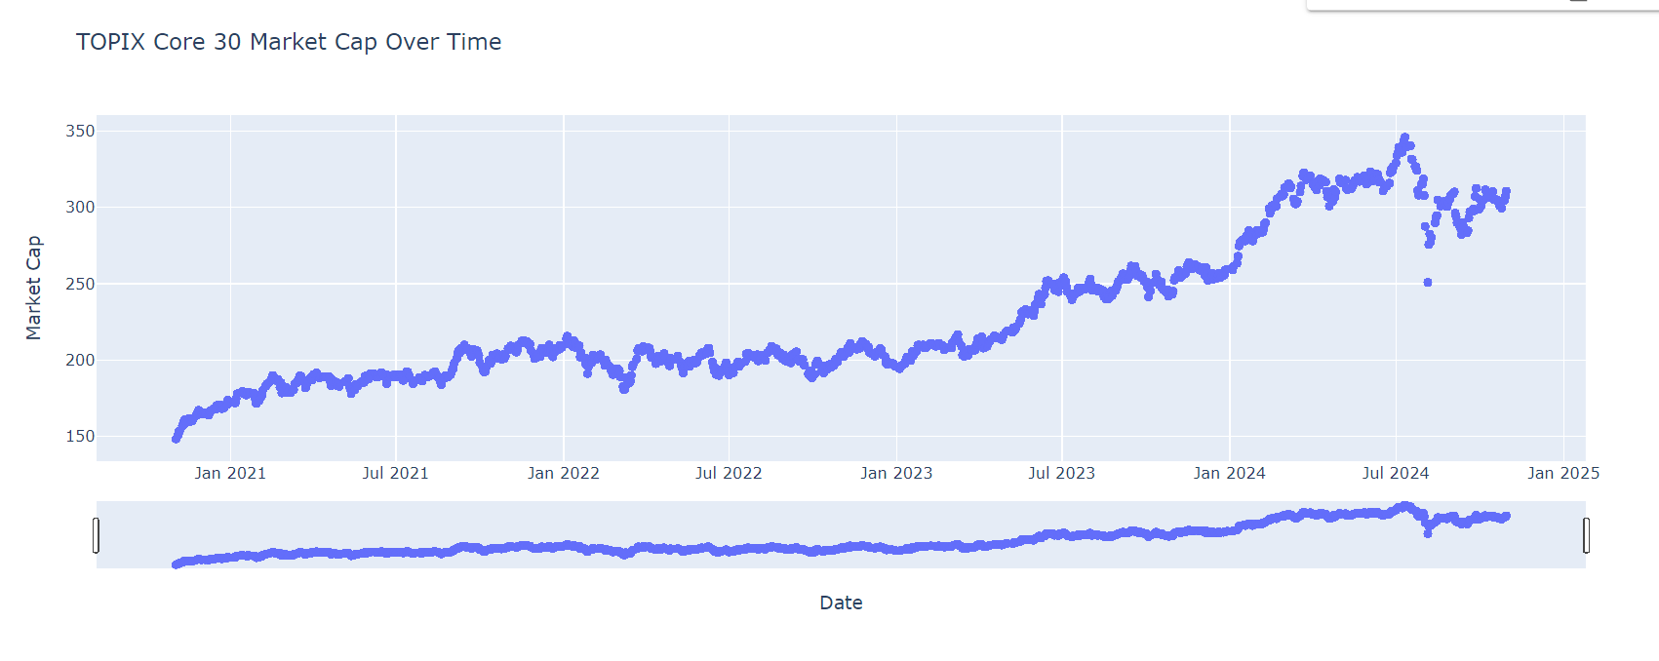
TOPIX Core 30 Market Cap

Slide 15
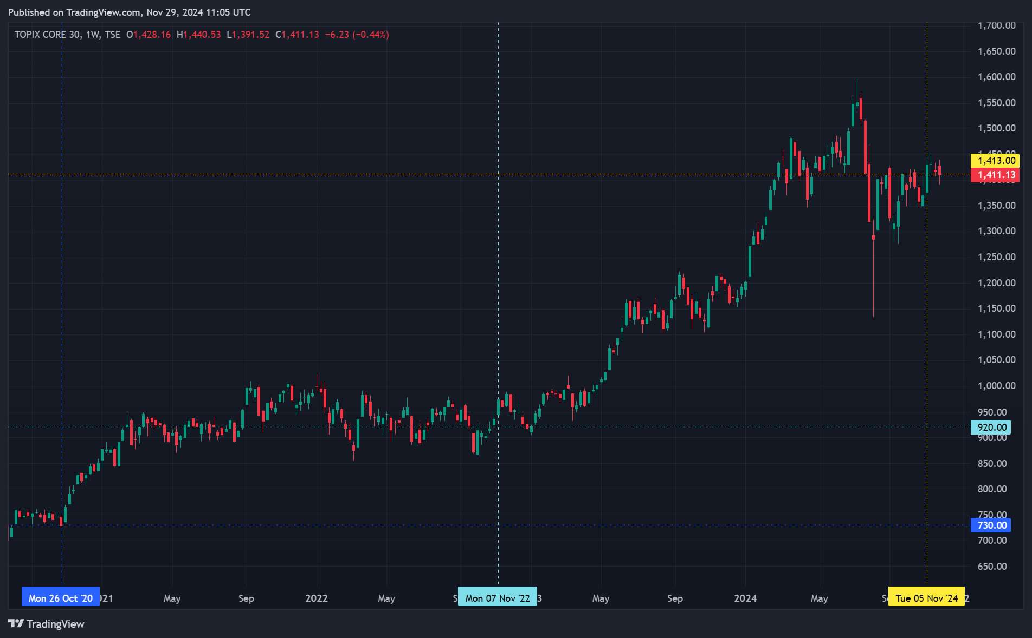
TOPIX Core 30 Trading View

Slide 16
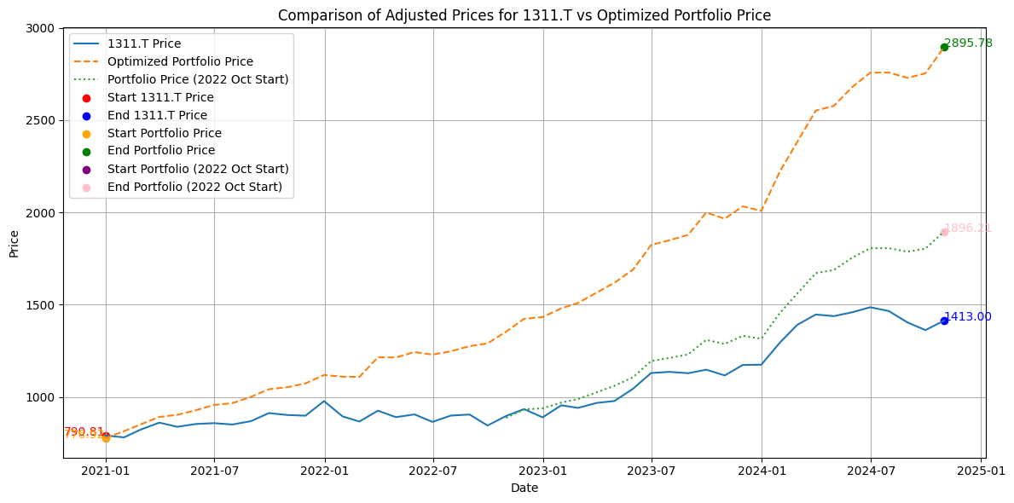
Optimized Portfolio vs Topix 30 Index

Slide 17
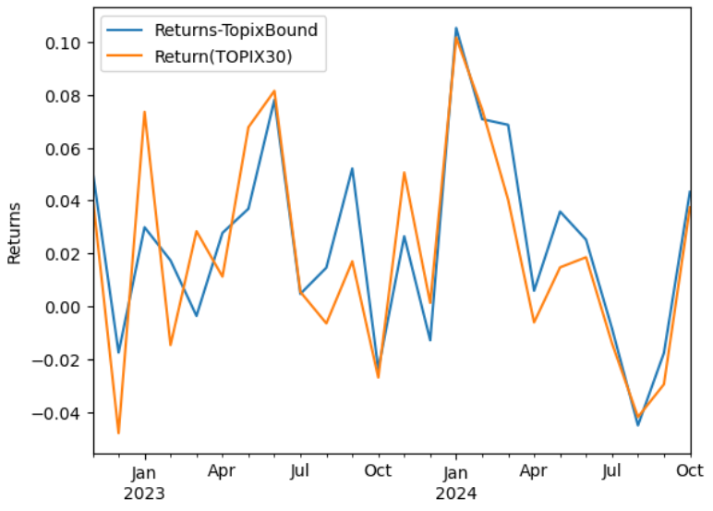
Monthly Return Comparison
Optimize the weights every month end
Choose these weights as the target portfolio for the next month
i.e. calculate return at 28-Feb 2024 by the weight at 31-Jan 2024
Compare the monthly return with the simply buying TOPIX Core30 (1331.T)
Our result shows similar trend of TOPIX Core30
For 2023, our result shows less volatility
For 2024, our result shows similar volatility but larger returns
Cumulative Return:
Ours: 0.6696
TOPIX30: 0.5760

Slide 18
Risk minimizing
Minimum Volatility
Minimum Risk Parity
Risk contribution of each stocks are almost the same
More balance and robust structure
Ref: An investigation of the Volatility Adjustment (https://link.springer.com/article/10.1007/s10203-023-00416-y) 14.4 Understanding Portfolio Volatility Risk
(https://bookdown.org/compfinezbook/introcompfinr/understanding-portfolio-volatility-risk-decompositions.html)

Slide 19
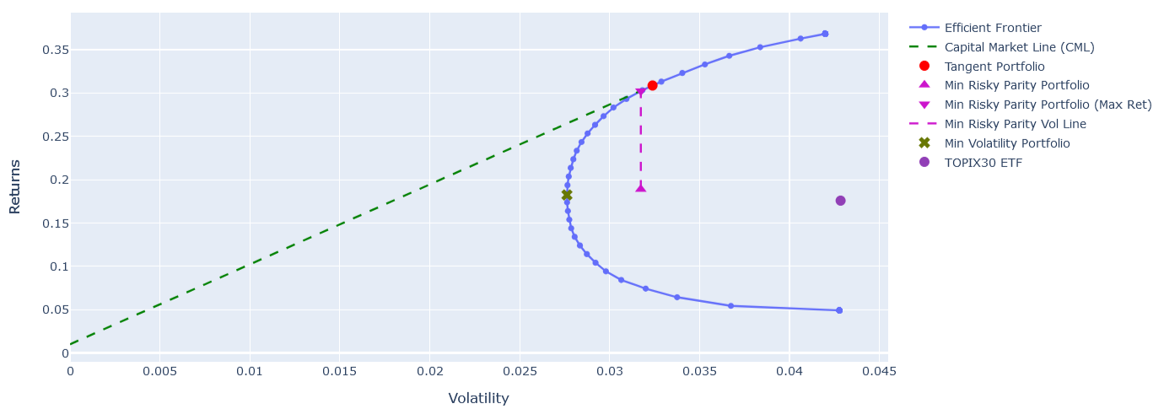
Risk minimizing
(0.03173, 0.3023)
(0.03239, 0.3087)
Topix30 (1331.T)
(0.04284, 0.1484)
(0.02762,
0.1824)
Max Sharpe Ratio
Return: 0.3087
Volatility: 0.03239
Min Vol:
Return: 0.1824
Volatility: 0.02762
Min Risky Parity (max Ret)
Return: 0.3023
Volatility: 0.03173
(0.03173, 0.1890)
** not an effective portfolio **

Slide 20
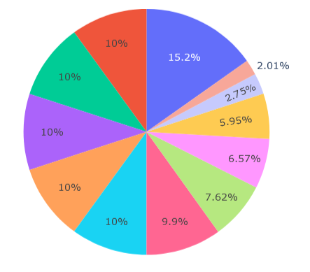
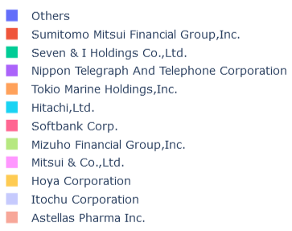
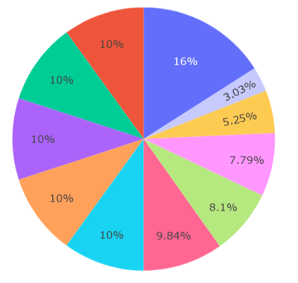
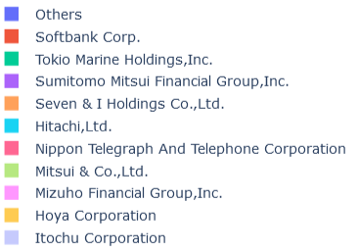
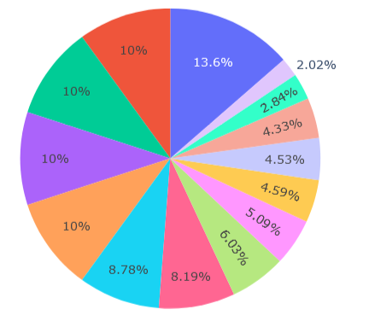
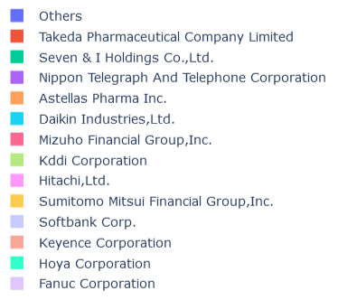
Minimum Risk Weight
Max Sharpe Ratio
Min Risky Parity with Max Return
Min Risky Parity with Max Return
Min Risk
Min Risk

Slide 21
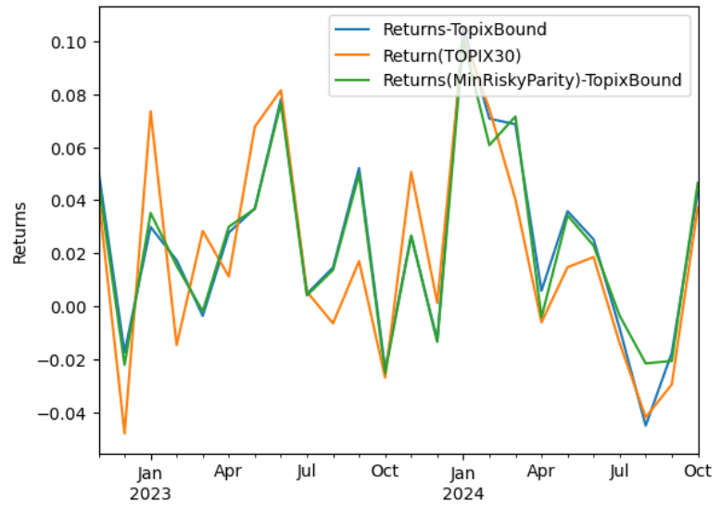
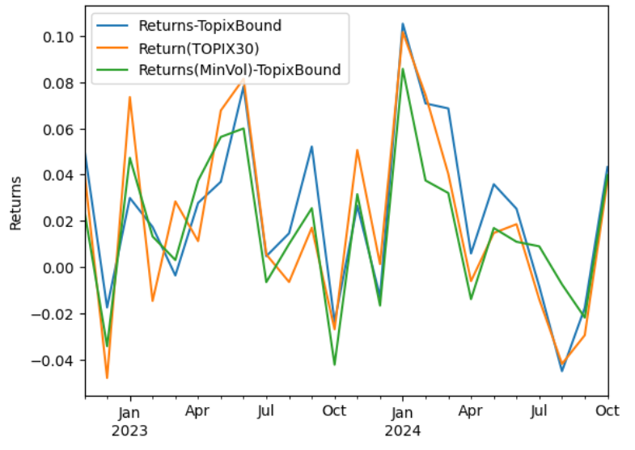
Minimum Risk
Min Risky Parity with largest return
Min Risk
Both green line show less variation but similar return to the blue line
Both green lines show less returns but less volatility

Slide 22
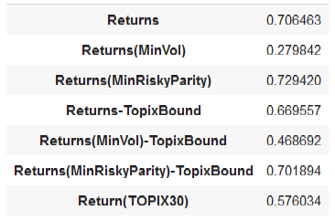
Risky Summarize:
Cumulative Return Comparison
Calculate the 2-year total return for each portfolio by the cumulative product 𝝥(1+ret) - 1
The min volatility portfolio has the less cumulative return
The min risk parity with max return portfolio has the largest cumulative return

Slide 23
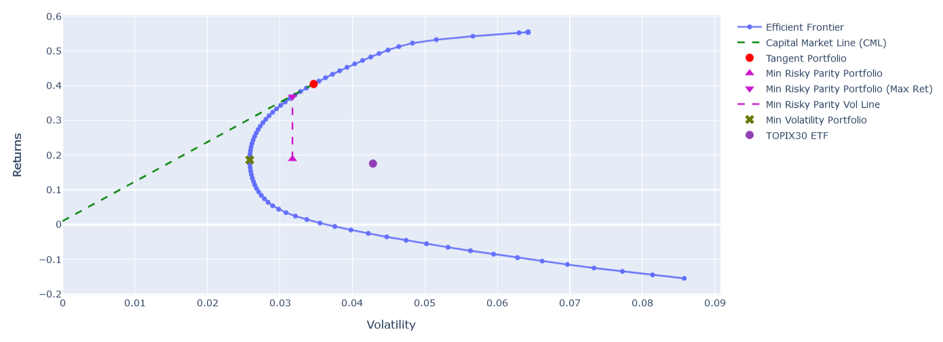
Relaxing the Weight bound (0, 1)
(0.03174, 0.3679)
(0.03466, 0.4046)
Topix30 (1331.T)
(0.04284, 0.1484)
(0.02584,
0.1860)
(0.03174,
0.1890)
** not an effective portfolio **
Bound: (0.008, 0.1)
Bound: (0, 1)
Max Sharpe Ratio
Return: 0.3087
Volatility: 0.03239
Min Vol:
Return: 0.1824
Volatility: 0.02762
Min Risky Parity (max Ret)
Return: 0.3023
Volatility: 0.03173
Max Sharpe Ratio
Return: 0.4046
Volatility: 0.03466
Min Vol:
Return: 0.1860
Volatility: 0.02584
Min Risky Parity (max Ret)
Return: 0.3679
Volatility: 0.03174
Max Sharpe Ratio: Ret (↑) Vol (↑)
Min Vol: Ret (↑) Vol (↓)
Min Risk Parity (Max Ret): Ret (↑) Vol (-)

Slide 24
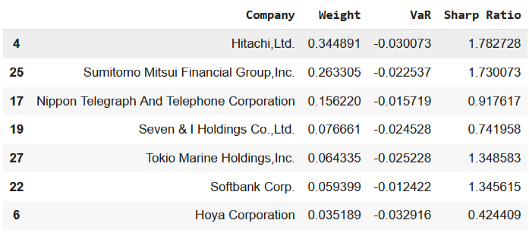
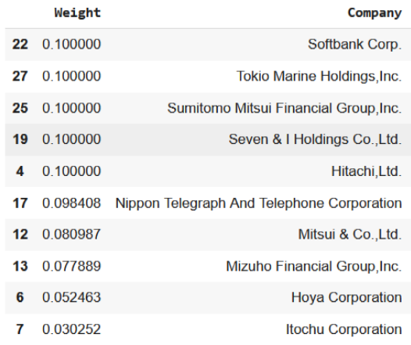
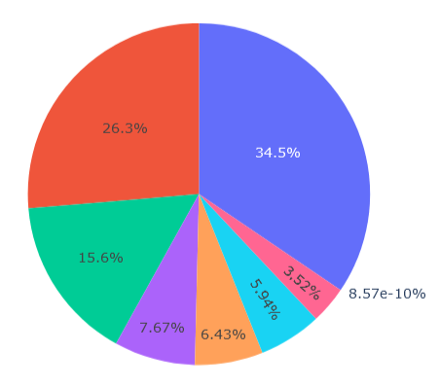
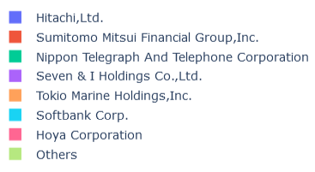
Weight Distribution (0,1)
(0.008, 0.1)
Only 7 stocks have non-zero weights (stocks are almost same as the max. weighted before)
large sharpe ratio stocks
0% for others

Slide 25
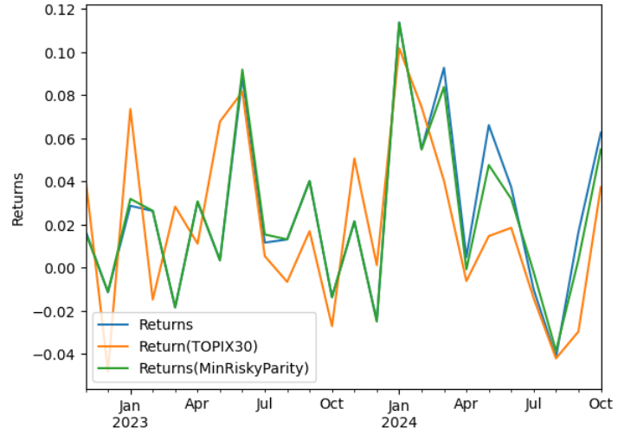
Monthly Ret. Comparison (0, 1)
The tangent portfolio (blue) and the min risk parity portfolio (green) can win the returns of TOPIX30 (orange)
Both tangent portfolio (blue) and min volatility portfolio (green) has smaller volatility than TOPIX30 (orange)

Slide 26
Risky Summarize:
Cumulative Return Comparison
Calculate the 2-year total return for each portfolio by the cumulative product 𝝥(1+ret) - 1
Compare to the (0.008, 0.1) bound cases, (0, 1) bound cases can provide greater cumulative returns

Slide 27
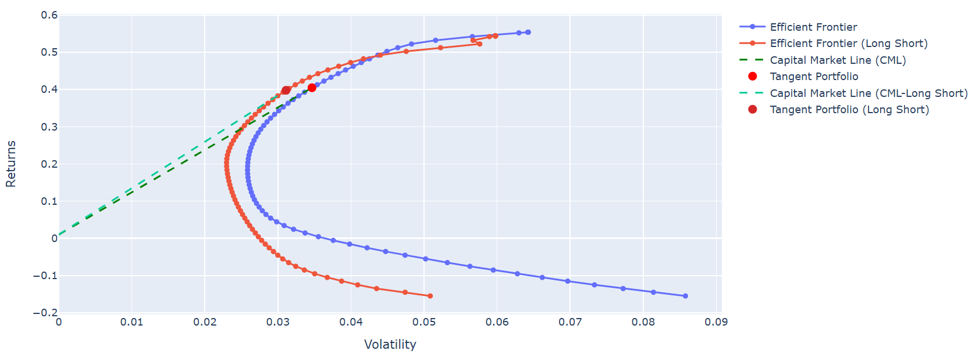
Long Short Leverage
Long Portfolio Bound: (0,1)
Long Short Portfolio Bound: (-0.1,0.1)
Long Portfolio
Best risk return trade-off
Long Short Portfolio
(0.0311,0.397)
(0.0347,0.405)

Slide 28
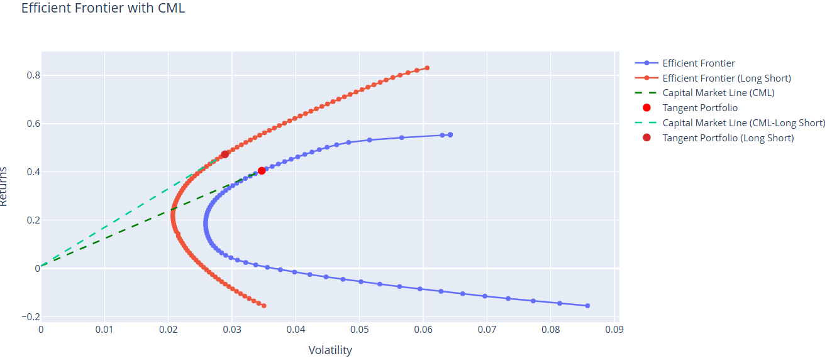
Long Short Leverage
Long Portfolio Bound: (0,1)
Long Short Portfolio Bound: (-1,1)
Widen bound
Greater return with higher risk (may be excessive)
Better sharpe ratio (best risk return trade-off)
Long Short Portfolio
(0.0289,0.473)
Long Portfolio
(0.0347,0.405)

Slide 29
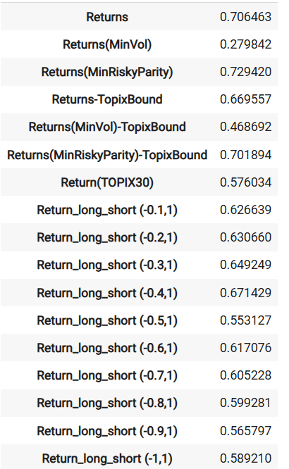
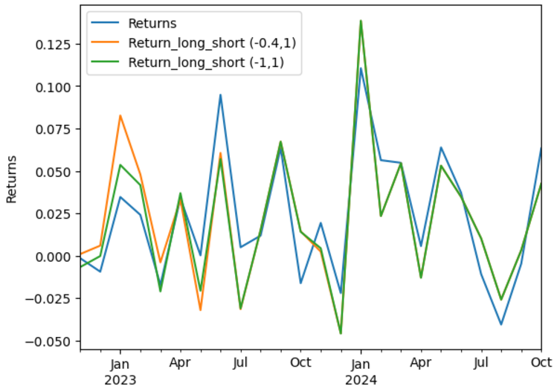
Summarize: Cumulative Returns Comparison
(Long only)
Calculate the total return for each portfolio by the cumulative product 𝝥(1+ret.) - 1
(Long short)
All these portfolio beat the return of TOPIX30 ETF (1331.T)!
Return of long only (0,1) > long short (-x,1) although returns of long short in efficient frontier beat long only.

Slide 30
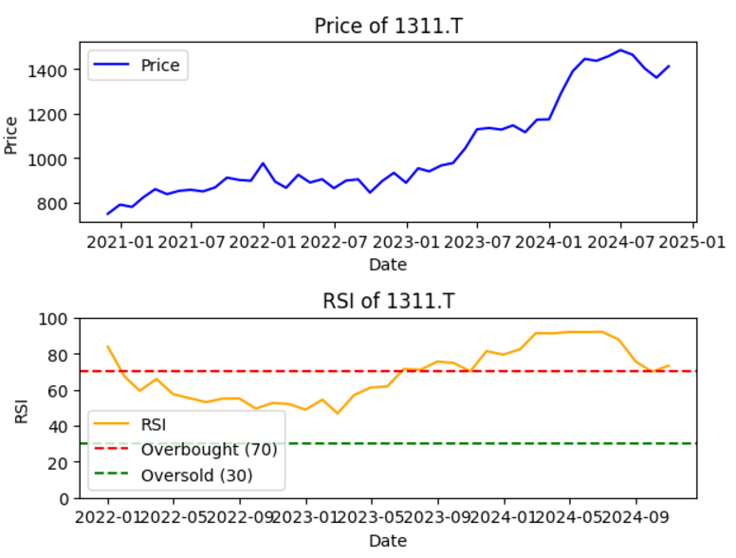
Long Short Leverage
Advantages and Drawbacks
Constraints difference between long only and long short:
Gross Exposure Limit plus short-> without leverage to achieve higher expected return
Main advantage of Long Short:
Better risk management
A conservative strategy
Trade off:
Could be a conservative strategy
-> may prevent the long-short portfolio from capturing all the upside
-> the ability to short can protect capital
-> The overall market environment can significantly impact the performance.
In a strong bull market, long-only portfolios (more aggressive) typically outperform, while long-short portfolios might lag due to the presence of short positions.
RSI index > 70, = strong market

Slide 31
Further Study
Stocks Selection for Portfolio Optimization (less than 30 Stocks)
Daily Re-balancing Optimization
Advanced Evaluation Metrics (Monthly + Daily)
Beta / CVaR
Skewness / Kurtosis / Jarque-Bera Test for Normality
Drawdown
Simulation Backtest (Monte Carlo Simulation / etc)
Long-Short Return Investigation on the Upper and Lower Bound (2D manifold)
Multi-Asset Portfolio Optimization (e.g. Stocks with Bonds)

Slide 32
REFERENCE
An investigation of the Volatility Adjustment (https://link.springer.com/article/10.1007/s10203-023-00416-y)
14.4 Understanding Portfolio Volatility Risk
(https://bookdown.org/compfinezbook/introcompfinr/understanding-portfolio-volatility-risk-decompositions.html)
Python Notebook Outputs: Weight optimization and portfolio returns using scipy.optimize.
Yahoo Finance Data: Historical stock prices for TOPIX Core30 components.
Visualization Libraries: matplotlib for weight distributions and effective frontier plots.
Mathematics for Finance: An Introduction to Financial Engineering, Marek Capinski, Tomasz Zastawniak, Springer
Corporate Valuation and Takeover, Robert Alan Hill
Mathematical Models in Portfolio Analysis, Farida Kachapova
Portfolio Theory & Financial Analyses, Robert Alan Hill

Slide 33
THANK YOU VERY MUCH

Slide 34
Appendix

Slide 35
Link to colab
https://colab.research.google.com/drive/1JpXzUuTpyM2rhF0cvcfCbey0wcSR3UQZ?usp=sharing

Slide 36
Annualizing Returns
The function annualize_rets calculates the annualized return based on the periodic returns provided. Here's a step-by-step explanation:
Input Parameters:
ret: A pandas Series or similar array-like structure containing periodic returns.
periods_per_year: The number of periods in a year (default is 12 for monthly returns).
Calculations:
compounded_growth = (1 + ret).prod(): This computes the total compounded growth over the given periods.
n_periods = ret.shape[0]: This retrieves the number of periods.
The function returns the annualized return using the formula: Annualized Return=(Compounded Growth)(Periods per YearNumber of Periods)−1\text{Annualized Return} = \left( \text{Compounded Growth} \right)^{\left( \frac{\text{Periods per Year}}{\text{Number of Periods}} \right)} - 1Annualized Return=(Compounded Growth)(Number of PeriodsPeriods per Year​)−1

Slide 37
Annualizing Volatility
The function annualize_vol computes the annualized volatility of the returns. Here’s how it works:
Input Parameters:
r: A pandas Series or similar array-like structure of returns.
periods_per_year: The number of periods in a year.
Calculations:
The function returns the annualized volatility calculated as: Annualized Volatility=Standard Deviation of Returns×Periods per Year\text{Annualized Volatility} = \text{Standard Deviation of Returns} \times \sqrt{\text{Periods per Year}}Annualized Volatility=Standard Deviation of Returns×Periods per Year​

Slide 38
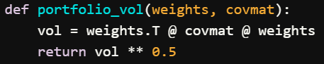
Portfolio Volatility
The function portfolio_vol calculates the volatility of a portfolio given the weights of the assets and the covariance matrix of the asset returns.
Function Definition
python
Input Parameters:
weights: A numpy array or pandas Series representing the weights of each asset in the portfolio.
covmat: A covariance matrix (as a DataFrame or 2D numpy array) that captures the covariances between asset returns.
Calculations:
The formula weights.T @ covmat @ weights computes the portfolio variance.
Taking the square root gives the portfolio volatility.

Slide 39
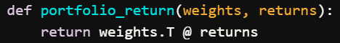
Portfolio Return
The function portfolio_return calculates the expected return of the portfolio based on the asset weights and their corresponding returns.
Function Definition
python
Input Parameters:
weights: A numpy array or pandas Series representing the weights of each asset in the portfolio.
returns: A pandas Series or numpy array of expected returns for each asset.
Calculations:
The formula weights.T @ returns calculates the weighted sum of the returns, giving the expected return of the portfolio.

Slide 40

Optimized Portfolio Weight (timeline)

Slide 41



Risk Parity Object
Each asset contributes to the risk based on
Weight
Relationship with the other assets (correlation and covariance).
the change in portfolio volatility due to a change in the weight of asset i
Minimize the risk by minimizing the sum square diff from each risk contribution to the mean
All assets are contributing equally to the portfolio's risk (risk contributions are equally distributed)

Slide 42






Minimum Risk Weight (0, 1)
Max Sharpe Ratio
Min Risky Parity with Max Return
Component almost no changes
Major weight less concentrated
Min Risky Parity with Max Return
Min Risk
Major stocks changed
Many other stocks
Min Risk

Slide 43

Relative Strength Index Indicator (RSI)
If rsi > 70, = strong market.

